Slide 1
Granularity

Slide 2
Introduction to Granularity – Part 1
Granularity refers to “the level of detail or summarization of the units of data in the data warehouse”
The low level of granularity contains high level of detail
The high level of granularity contains low level of detail.
The level of granularity affects database performances.
If the DW has many levels of explorable data layers, it is supposed to be more granular.

Slide 3
Introduction to Granularity – Part 2
In a DW environment, granularity directly represents the richness of data quality and consequently establish the intensity of database queries
To aggregate the data you need of course the same granularity.
That means a Weekly report only can get generated when you have daily transactions data.
Similarly a Daily report only can get generated when you have hourly transactions data.

Slide 4
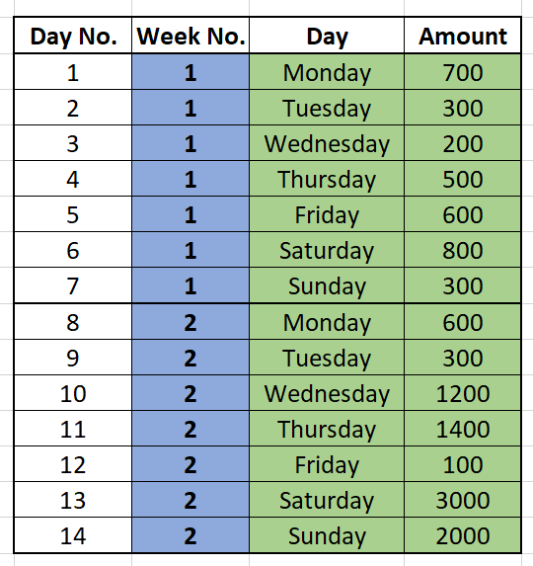
Example 1 of Granularity
A more finer granular Weekly Data can have a Daily Data of transactions.

Slide 5
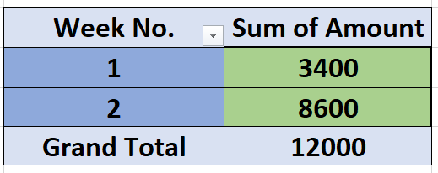
Example 1 of Granularity -- Continued..
Weekly Total Amount

Slide 6
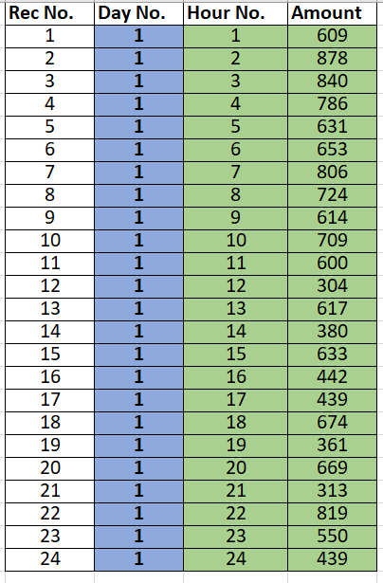
Example 2 of Granularity
A more finer granular Daily Data can have a Hourly Data of transactions.

Slide 7
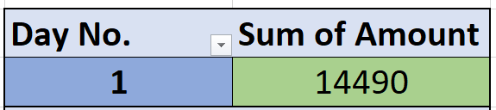
Example 2 of Granularity – Continued…
Total Amount of the entire Day

Slide 8
Granularity And Data Storage
Granularity will determine your storage space.
The more finer your granularity is, the more data you have to store.
The less finer your granularity is, the less data you have to store.

Slide 9
Identifying the level of detail
The level of detail that is available in a star schema is known as the grain.
Each fact and dimension table has its own grain or granularity.
The grain of the dimensional model is the finest level of detail that is implied when the fact and dimension tables are joined.
Best example will be, the granularity of a dimensional model that consists of the dimensions Date, Store, and Product is product sold in store by day.

